Slide 1
Python 3
Something Nice here
Joel Enrique Esparza Ramirez
Internet of Things

Slide 2
*Python logo and welcome message

Slide 3
Introduction
Part 1

Slide 4
*Python
Add python definition, history and relevance

Slide 5
*HOW TO INSTALL PYTHON

Slide 6
*HOW TO INSTALL VSCODE & PYCHARM

Slide 7
Hello world
Lecture 1

Slide 8
PART 1
Values and data types

Slide 9
Variables
Definition

Slide 10
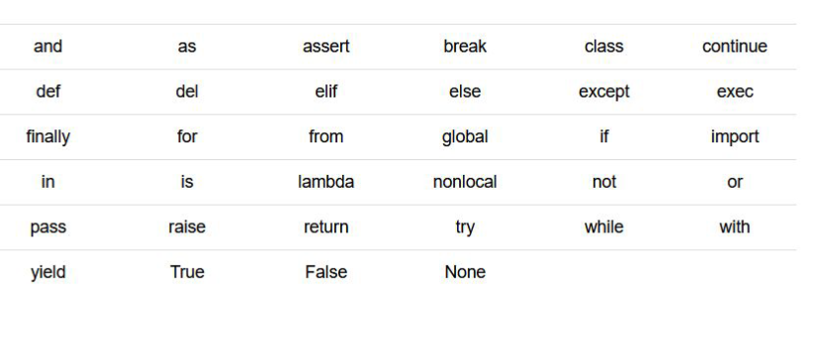
Exceptions

Slide 11
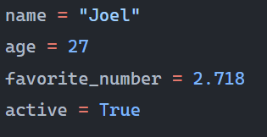
Assignment

Slide 12
VALUES
INT
FLOAT
STRING
BOOLEAN

Slide 13
Type(VARIABLE)

Slide 14
VALUEs
Lecture 2

Slide 15
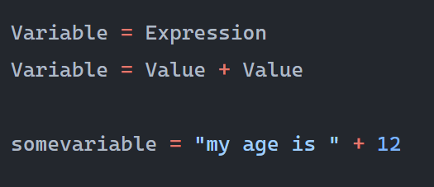
expressions

Slide 16
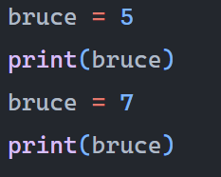
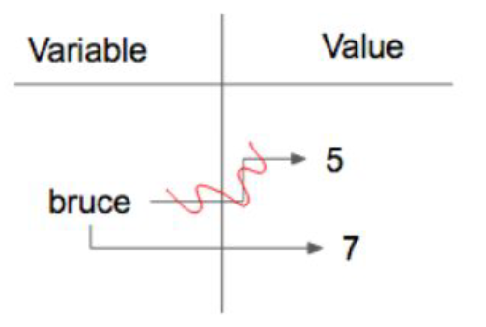
Reassignment

